Slide 1
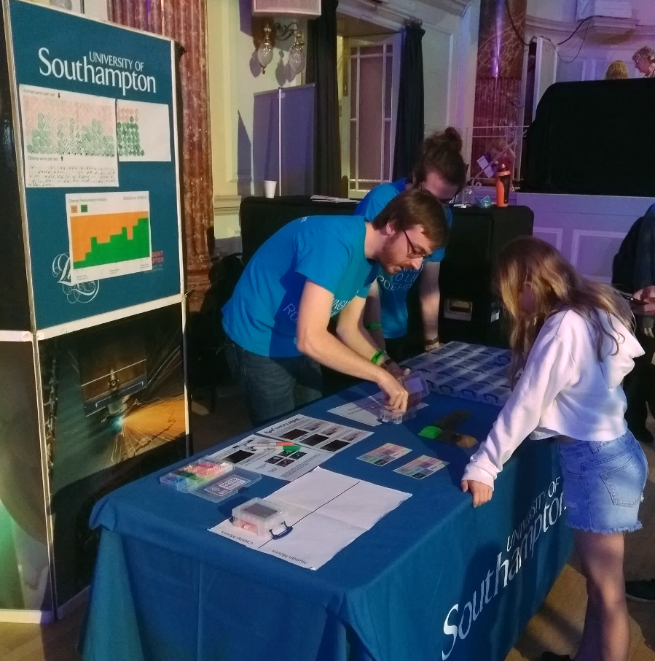
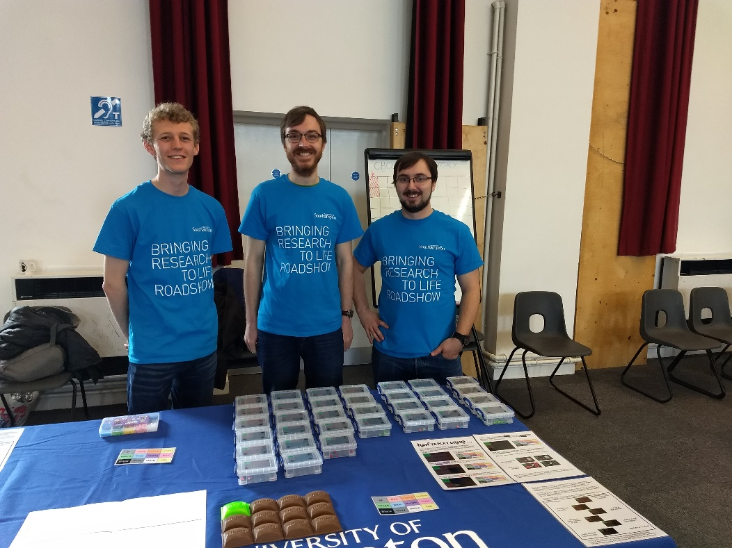
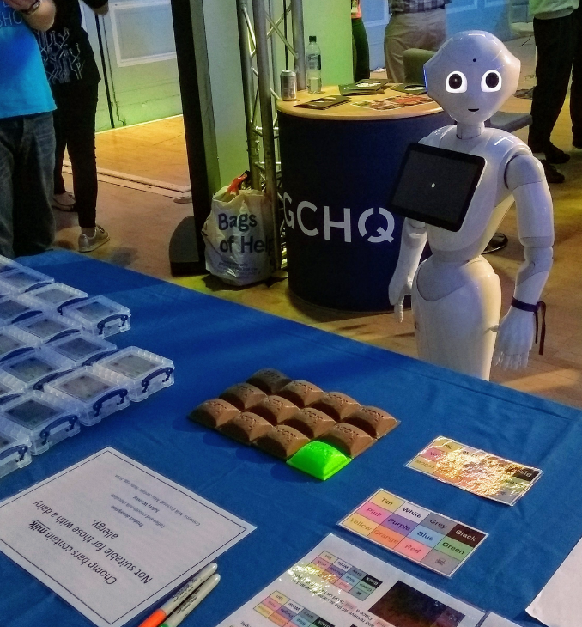
Machine learning with CHOMP

Slide 2
Chomp is a Machine Learning demonstration with: No Maths… No Jargon… No Computers!

Slide 3
How to play:
Take turns taking bites out of the bar of chocolate from the bottom right…
If you eat the poisoned square, you lose!

Slide 4
Introducing CHOMP: the CHocolate Orientated Mechanical Processor*
*or Chomp Has Outperformed Many People

